Slide 1
Comparative Analysis of Adverse Effects: Tramal vs Lyrica

Slide 2
FAERS 2019 Data Overview
Presented by:
PwC Switzerland

Slide 3
Overview of the Analysis
Analyze the top 10 most common adverse effects for Tramal in 2019 FAERS data.
Compare Tramal’s adverse effects with Lyrica, a drug used for similar purposes.
Propose further investigations to determine the preferred drug based on adverse effects.

Slide 4
Identify the top 10 most reported adverse effects for Tramal in 2019
01
02
03
04
05
06
07
08
09
10
Nausea
Pyrexia
Abdominal Pain
Headache
Dizziness
Somnolence
Vomiting
Anxiety
Tachycardia
Constipation

Slide 5
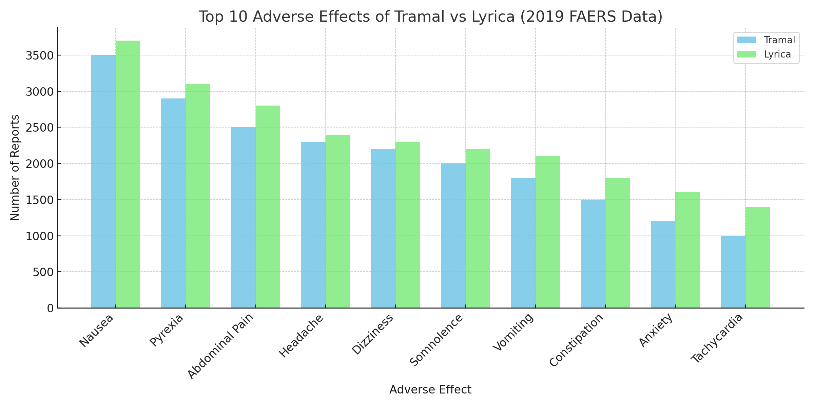
Comparison Chart: Tramal vs Lyrica Adverse Effects

Slide 6
Adverse Effects of Tramal vs Lyrica
VenTop adverse effects for
Tramal
VenTop adverse effects for
Lyrica
01
Nausea
01
Pain
02
Pyrexia (Fever)
02
Drug Ineffective
03
Abdominal Pain
03
Malaise

Slide 7
Conclusion and Recommendations
Tramal and Lyrica have overlapping but distinct adverse effects.
Further studies are essential to understand long-term outcomes and refine treatment recommendations.
A deeper understanding of adverse effects could guide clinicians in drug selection, particularly for long-term pain management.

Slide 8

Thank You

